Slide 1
Reasoning modelling

Slide 2
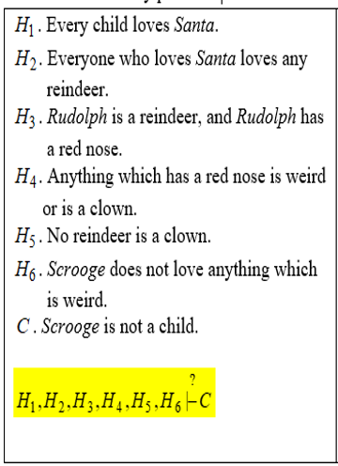
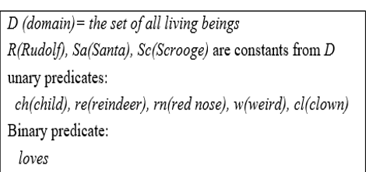
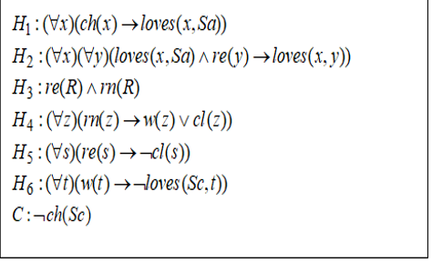

Example 1

Slide 3
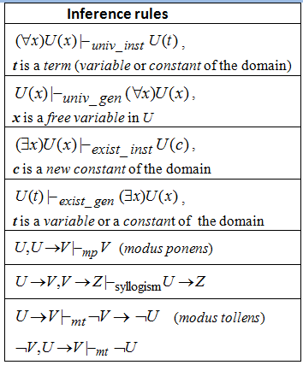
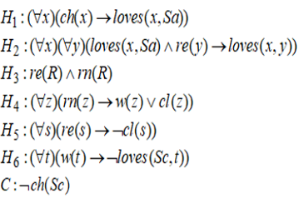

Slide 4
Linear resolution

Slide 5

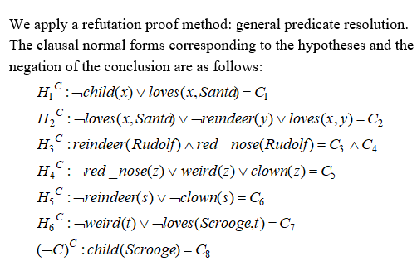
Example 1 (contd.)

Slide 6
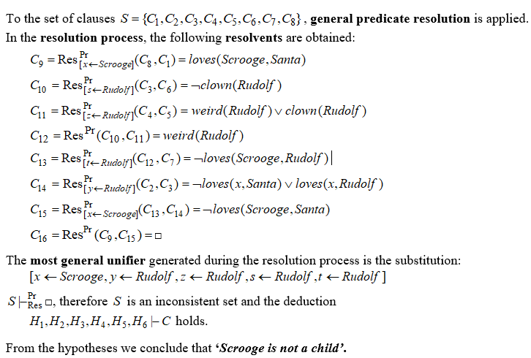
Example 1 (contd.)

Slide 7
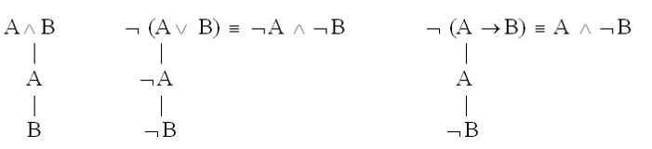



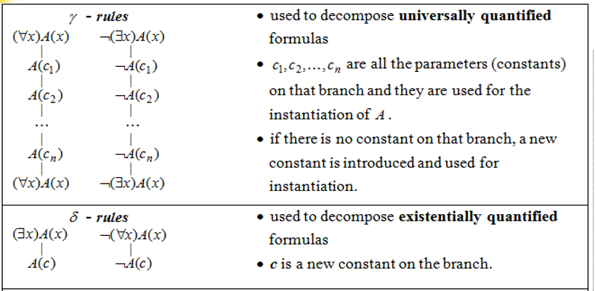
Decomposition rules for predicate formulas

Slide 8
Remarks
A formula is inconsistent if it is evaluated as false in all its interpretations. It is necessary to show that the formula does not have models, all its interpretations are anti-models.
To prove that a formula is not inconsistent it is sufficient to find a model for it.
A formula is valid (tautology) if it is evaluated as true in all its interpretations. It is necessary to show that the formula has only models. Its negation is inconsistent.
To prove that a formula is not valid it is sufficient to find an
anti-model for it.
To prove that a formula is contingent it is sufficient to find a model and an anti-model for it.

